Slide 1
Application of TEK to examine the links between well-being of Aboriginal people and ES from the Tropical Rainforests in north Queensland
SGA presentation on the 27th of Nov 2012 by Kamaljit K. Sangha
James Cook University, Australia

Slide 2
Outline
Background
TEK in the Aboriginal Australian context
How we applied TEK in the MA case study?
Conclusions
Questions?

Slide 3
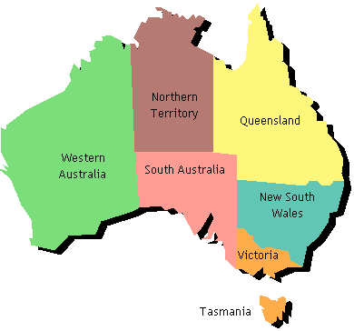
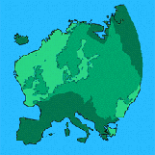
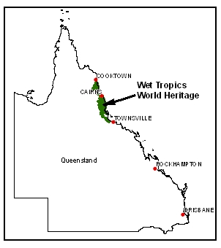
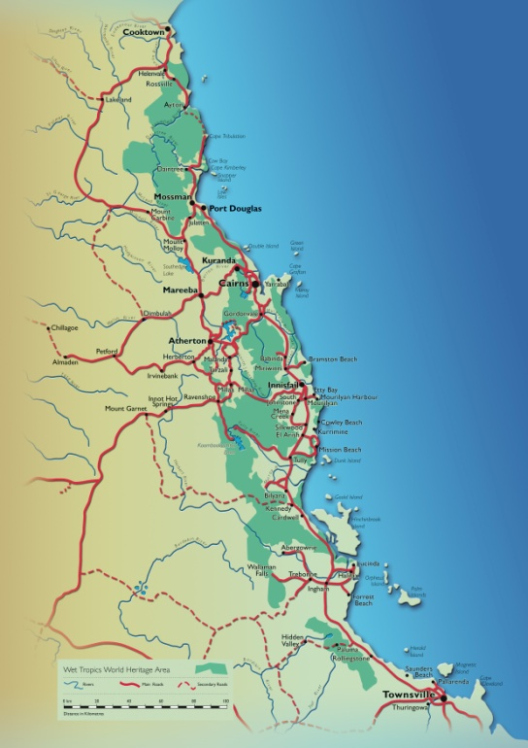
Beauty of tropical rainforests………

Slide 4
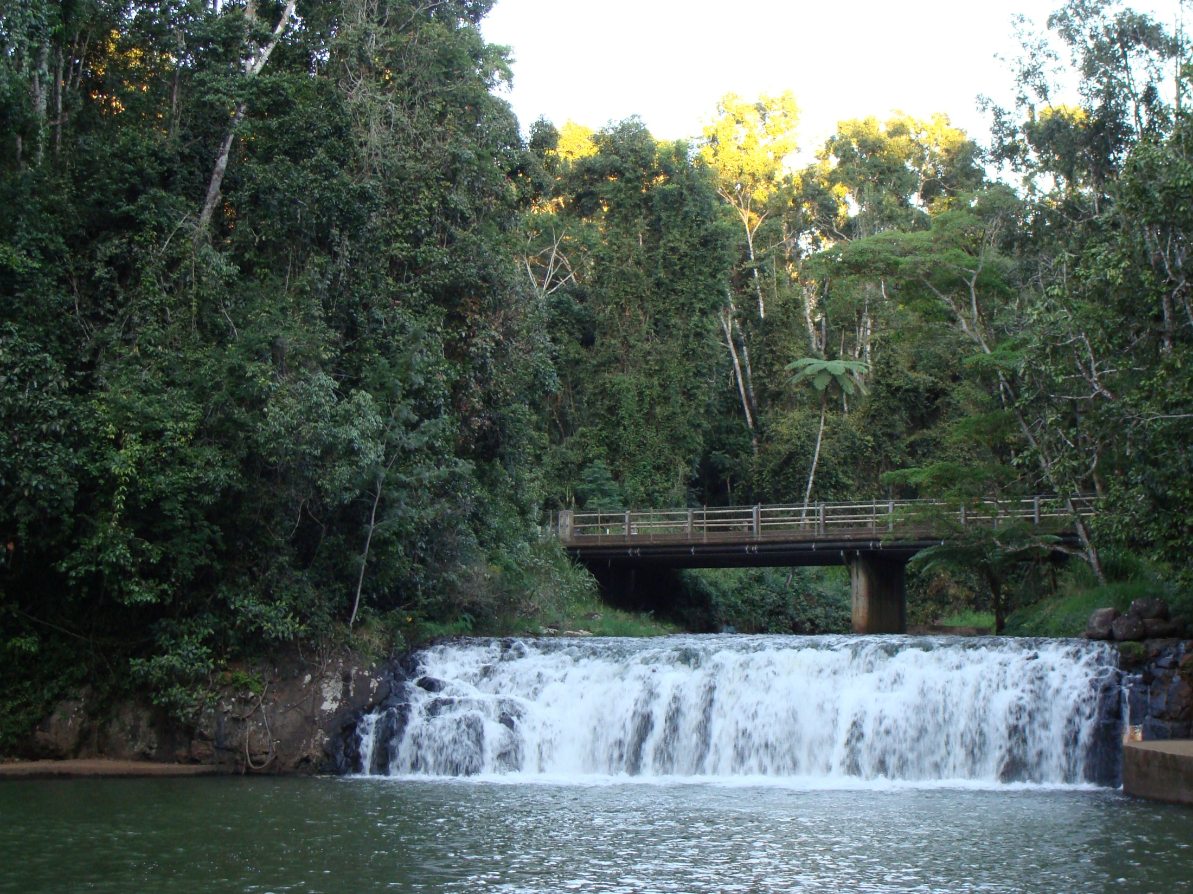

Slide 5
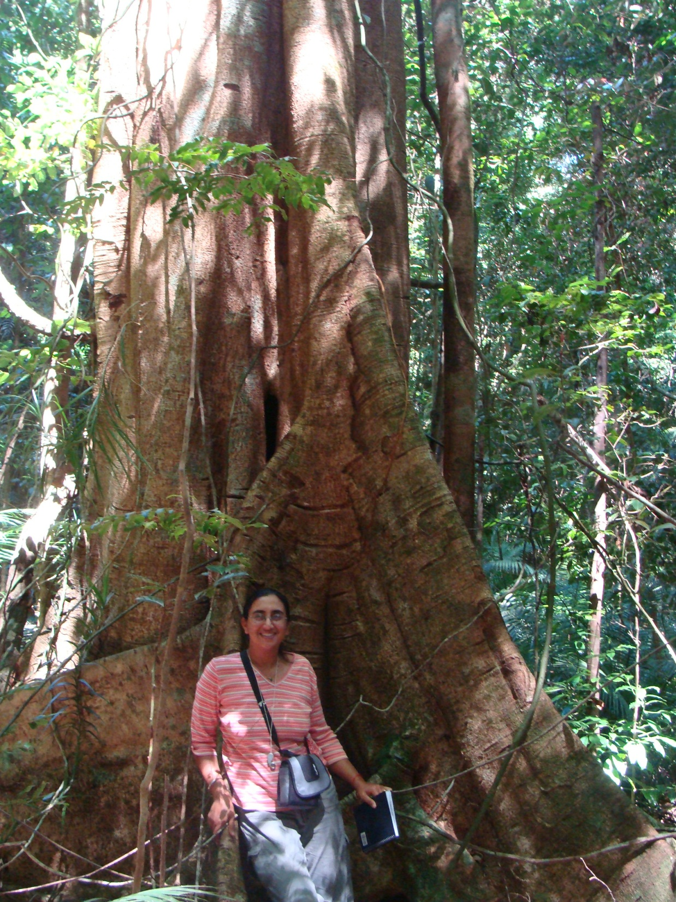
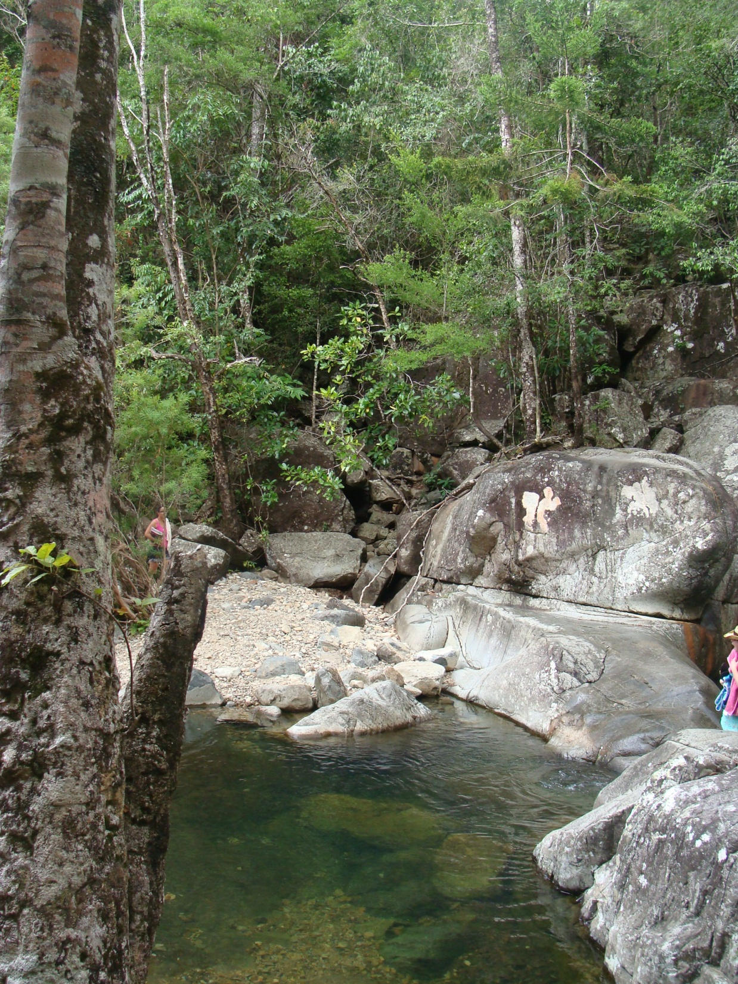

Slide 6
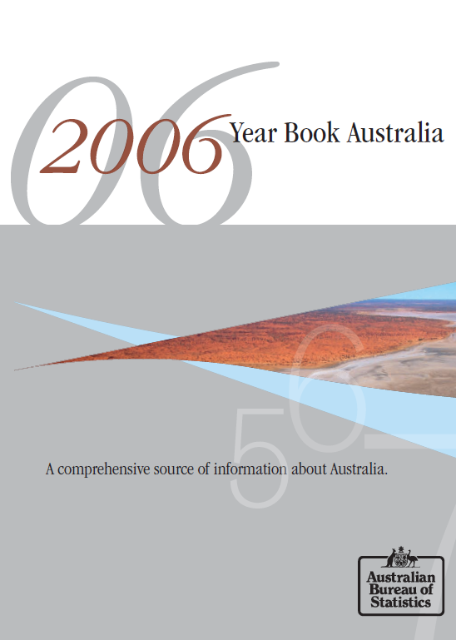
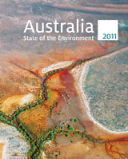

Background

Slide 7
What am I doing here?
ES and their LINKS to HWB, not just the status of ECOSYSTEMS
Monetary/non monetary valuation or evaluate direct role in HWB
HWB
Ecosystem services
Natural resources
Policy decision
making

Slide 8

Background
 | Aboriginal | Non-Aboriginal
Natural resources:
Land | Related, Sacred | Ownership, Secular
Environment | Adapt to | Exploit
Other social values:
Society | Unified | Diverse
Relationships | Extensive | Limited
Basic unit | Society | Individual
Reality | Spiritual | Material
Possessions | Share, Use | Acquisitive, Accumulate
(Source: Edwards 1988)

Slide 9

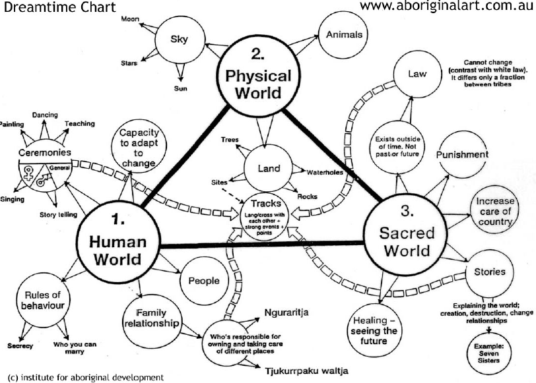
Interconnected physical, spiritual and human world

Slide 10
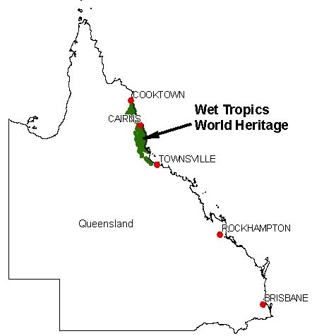
Wet Tropics: Case study
The Wet Tropics World Heritage area (WTWHA) is recognised as a series of living cultural landscapes being the homelands of rainforest Aboriginal people (WTMA, 1998).
People’ lives, customs and beliefs are intricately entwined with the plants, animals, waterways and seasons of the tropical rainforests which have provided food, shelter, medicine and other numerous services since Aboriginal settlement over 40 000 years ago (Lee long, 1992).

Slide 11
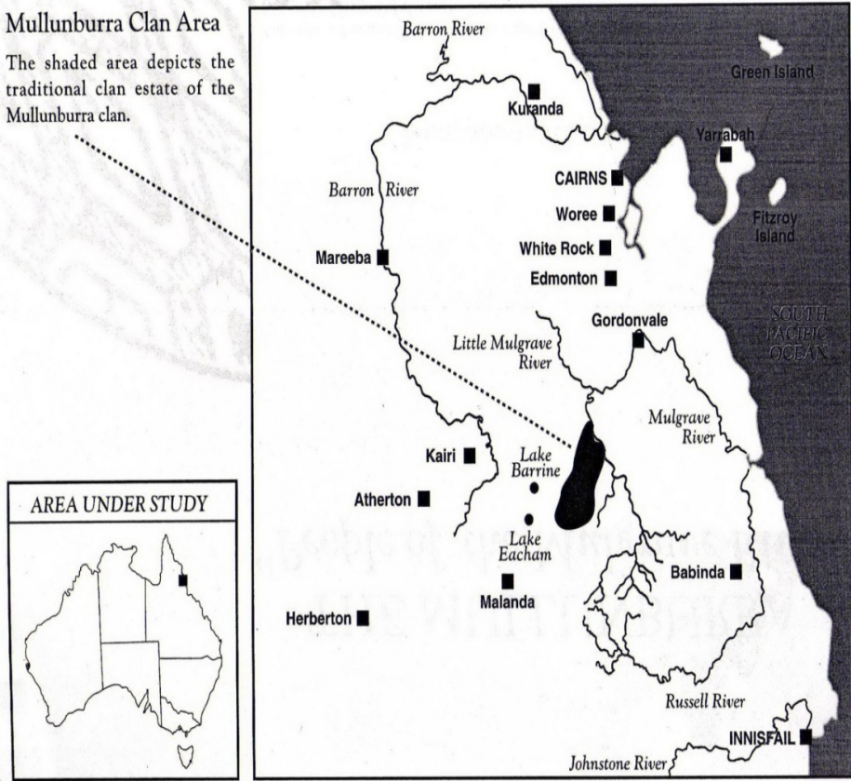
Wet Tropics: Case study
Indeed the entire region is imbued with cultural meaning and Aboriginal history, and can be described as an Aboriginal cultural landscape (Review Steering Committee 1998)
Currently, there are a total of 18 Aboriginal tribal groups representing around 50 clans in the WTWHA, with approximately 20 000 Aboriginal people living in the region (WTMA, 2006).

Slide 12
Approach
Applied the MA framework to identify the links between ecosystem services and the constituents of human well-being
Qualitative approach: Focus group meetings with the community

Slide 13
Main aspects of the study
What well-being means to people?
“To feel good...both in my body and in my mind”
“Spend time with my grand-children”
“To be happy with myself”
“To have time to do what I want”
“Spend time with my family...or the other ladies”
“It is to be on country”
“It is to be free to go on country when I want”.

Slide 14
Main benefits that people associated with the country
“Food, because it is fresh, natural and healthy”
“Medicines, because they are natural, and still used by the people”
“Spiritual connection through initiation and dreaming stories”
“Healing place, good for health”
“Provides a sense of identity. For example, country provides material for shield making that is always different from one clan to another, and this is our identity”
“Provides places to practice our traditional and cultural ways”

Slide 15
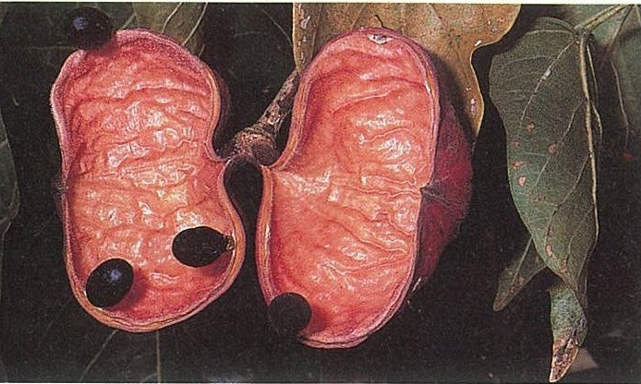
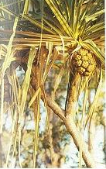
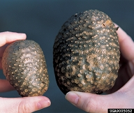
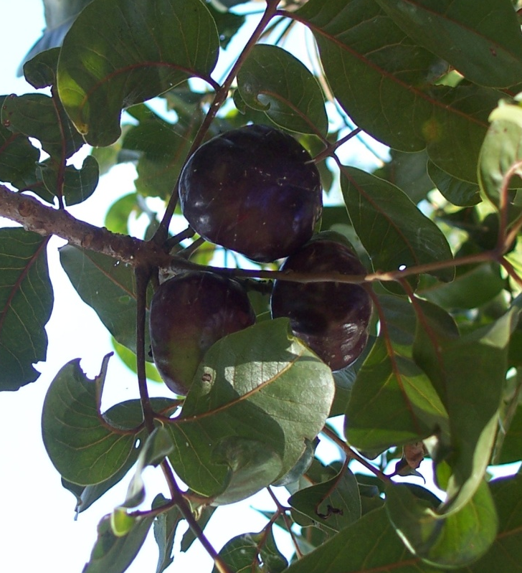
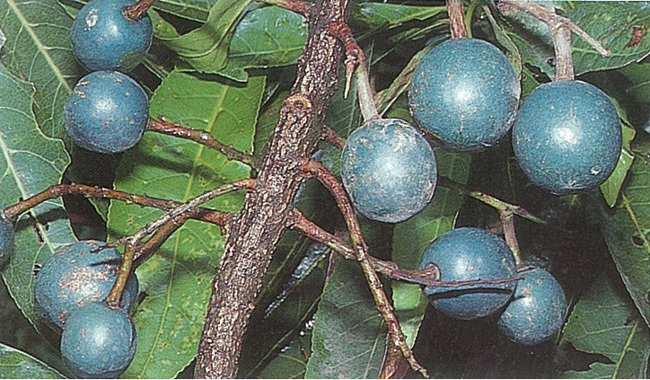

Slide 16
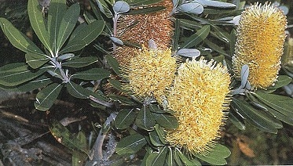
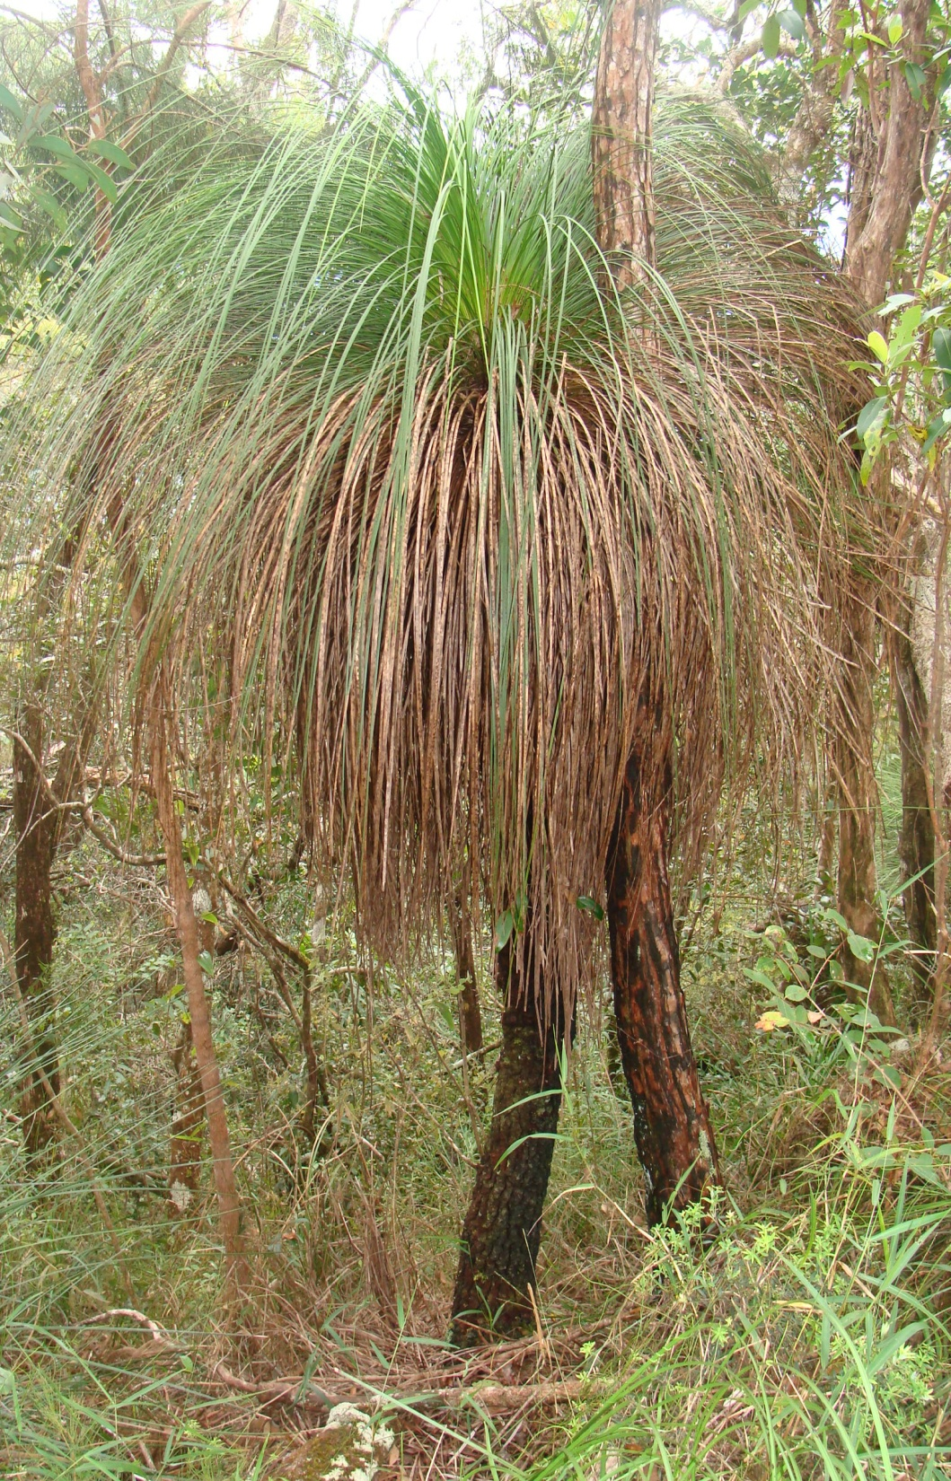
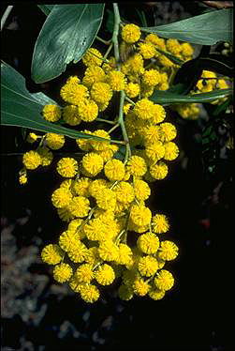
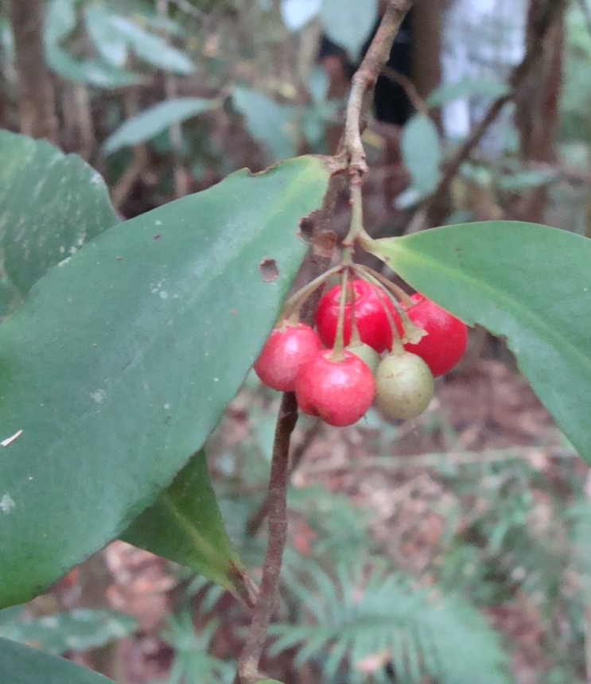

Slide 17
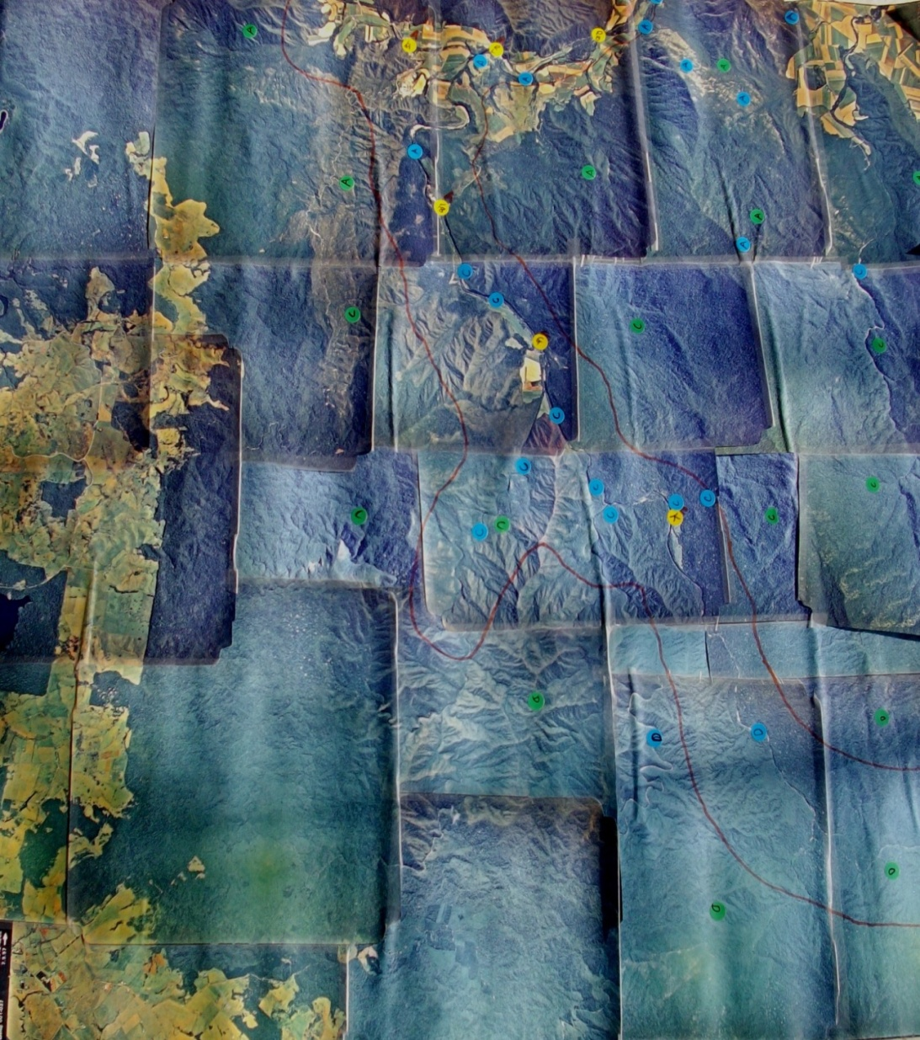
Marking cultural and other places on the map
Significant wild resource use places by Mullunburra-Yidinji men (Map of the clan area)
Total 70 places, under 4 categories: Recreational/Cultural, Story, Burial and Food areas

Slide 18
Ranking of significant areas
Low | Medium |  | High
MEN:
Public recreational areas, Public tracks |  | Walking tracks, Camping grounds, Teaching areas and Fish traps | Fire places, Story places, Burial sites, Ceremonial places, Food areas, Initiation areas, Hunting areas, and Areas for tool materials
WOMEN:
Recreation areas | Walking tracks, Fish traps, and Hunting areas |  | Story places, Burial sites, Healing places, Camping grounds, Initiation areas, Medicine and food areas

Slide 19
Ranking of benefits from natural areas
Low | Medium | High
MEN:
Recreation | Food and Medicine | Spiritual values, Language, Identity values, Tools and Cultural values
WOMEN:
Recreation | Food, Fishing/hunting and Gathering with the family | Spiritual values, Language, Identity values for keeping the culture alive and Transfer of knowledge

Slide 20
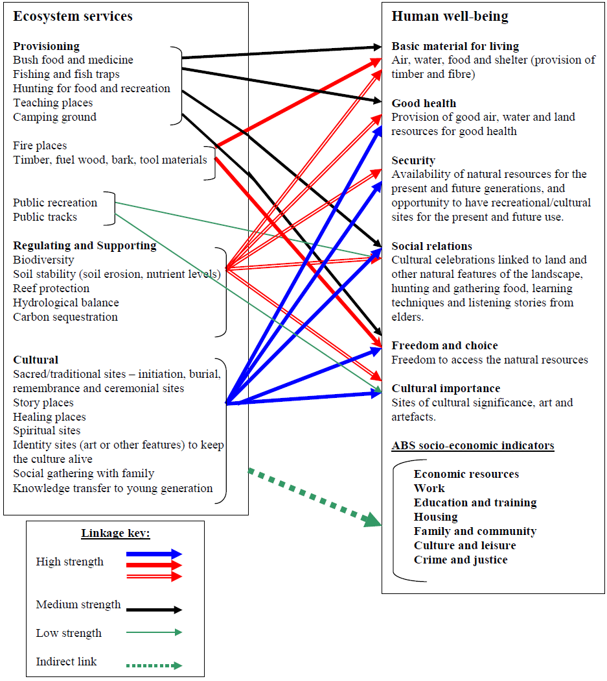

Slide 21
Proportional (direct) contribution of ecosystem services in the well-being of Aboriginal and non-Aboriginal people (hypothetical figures)
Changes
over time
Indirect contribution of ecosystem services

Slide 22
Main results
Mullunburra- Yidinji people’s well-being is strongly linked to the Cultural and Provisional services of natural resources.
None of these attributes are considered in the well-being attributes applied by the Australian Bureau of Statistics.
We are trying to develop an integrated framework that includes socio-economic and ecological attributes to accurately reflect the well-being of Indigenous people.

Slide 23
Next….
We’ll be conducting a detailed study in the southern part of Queensland to explore the links between well-being and ES, including:
ES: types, valuing, mapping, impacts of climate change (at the regional and local scale)
and linking each aspect of ES to the well-being of Aboriginal people

Slide 24
References
Kamaljit Kaur (2007). Linking ecosystem services to well-being: A case study of Aboriginal communities in north Australia. Australian Aboriginal Studies, Issue 2 (2007): 145-147.
Kamaljit Kaur Sangha, James Burtler, Aurelie Delisle and Owen Stanley (2011). Identifying links between ecosystem services and Aboriginal well-being and livelihoods in north Australia: applying the Millennium Ecosystem Assessment framework. Journal of Environmental Science and Engineering (issue 5, 2011), pp. 381-387.
MTSRF project report, and M.Sc. thesis by Aurelie Delisle, JCU.
Kamaljit Kaur (2006). The role of ecosystem services from tropical savannas in well-being of Aboriginal people: A scoping study. A report for the Tropical Savannas Cooperative Research Centre, Darwin, NT.
Review Steering Committee 1998 Which Way Our Cultural Survival—The review of Aboriginal involvement in the management of the Wet Tropics World Heritage Area. Wet Tropics Management Authority. Cairns.

Slide 25
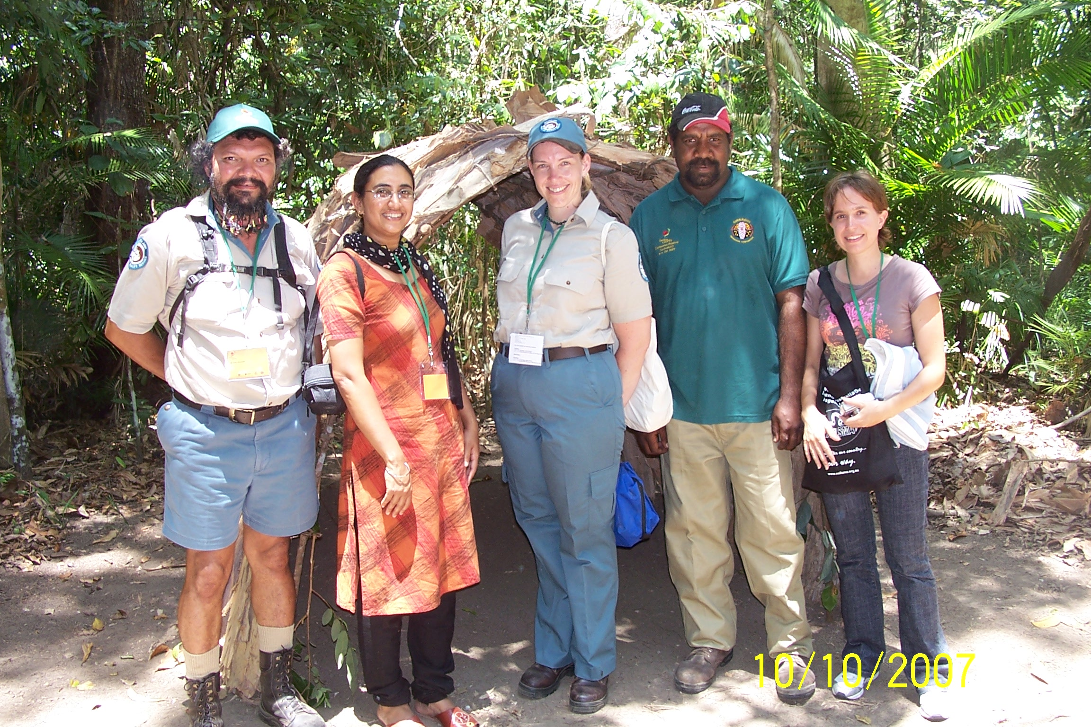
Thanks!

Slide 26
Acknowledgements
Mulluburra-Yidijni people
James Cook University and MTSRF (CSIRO)
SGA network
Contact: kamaljit.kaur@jcu.edu.au

